Slide 1

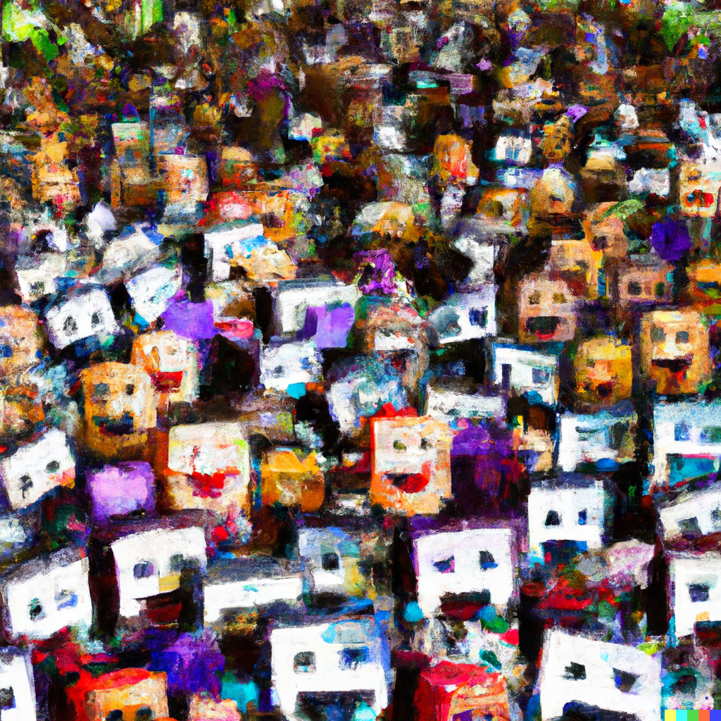
Case Studies of Sociodemographic Biases by Artificial Intelligence Models
Shomir Wilson
Associate Professor
College of Information Sciences and Technology
The Pennsylvania State University
DALL-E prompt: “impressionist painting of a crowd of happy and sad computers”

Slide 2









Affiliation History
Primary Affiliations
Secondary Affiliations
1
1
2
4
5
3
Current
3
5
6
¹ Student and researcher
² Postdoc and lecturer
³ Tenure-line faculty
⁴ Part-time student
⁵ Visiting scholar
⁶ Visiting postdoctoral fellow
Notes:
I show this in part to give some credit to the institutions where I’ve done work but also to show students what’s possible

Slide 3

The Human Language Technologies Lab at Penn State
Our research combines natural language processing, privacy, and computational social science.
Current Ph.D. student: Shahriar Shayesteh
Current M.S. students: Sinjoy Saha, Yihao Zhou
Current undergraduates: Felicia Vijayarangam, Lineesha Kamana Ph.D. alumni: Younes Karimi, Mukund Srinath, Pranav Venkit
M.S. alumni: Sonu Gupta, Duo Pan, Soundarya Sundareswara, Abhijith Athreya, Baradwaj Aryasomayajula
Past undergraduates: Avi Bewtra, Grace Ciambrone, Minh Doan, Miranda Goodman, Matthew Ihlenfield, Samantha Kenny, Juan Larenas, Ananya Nijhawan, Nora O’Toole, Ellen Poplavska, Benjamin Siri, Josephine Soddano, Eesha Srivatsavaya, Kaitlyn Wassel
Notes:
Speaking of students

Slide 4
Natural Language Processing
Measuring bias in language models;
Extraction of orthographic document structure;
Empirical study of metalanguage in English
NLP on privacy policies and related texts;
Analysis of email scams directed at universities;
Detection of doxing on social media
Choice architecture for user privacy;
Location sharing privacy
Large-scale analysis of water service disruptions via news text
Privacy behaviors on social media
Socioeconomic impacts on privacy behaviors;
Equity issues in police radio communications
Computational Social Science
Privacy and Security
Notes:
When you move your home from one place to another, you get rid of things
When you move in the sense of an academic career, the opposite happens: you accumulate things…

Slide 5
Artificial Intelligence and Biases
Frequently, AI is about models: representations of the likelihoods of phenomena, often as words or images.
These models are trained on data from the internet.
It seems logical that these models inherit biases from training data. How can we measure those biases?

Slide 6

Three Projects
I’ll discuss these projects from my lab:
How disability words affect sentiment analysis and toxicity detection
How nationality biases can be measured in text generation
How image generation models reflect biases surrounding a non-western culture
Pranav Venkit
Recent PhD grad form my lab
Now a Research Scientist at Salesforce

Slide 7
Project #1: Disability Words, Sentiment Analysis, and Toxicity Detection
Prior work showed that large language models (LLMs) exhibit gender and race biases. Do LLMs exhibit biases against people with disabilities too?
We test several popular LLMs for bias. I’ll share a subset of the results today, specifically on BERT and GPT-2.
These results are from:
Automated Ableism: An Exploration of Explicit Disability Biases in AIaaS Sentiment and Toxicity Analysis Models. Pranav Narayanan Venkit, Mukund Srinath, and Shomir Wilson. In Proc. TrustNLP, 2023. Best Short Paper Award.
A Study of Implicit Language Model Bias Against People with Disabilities. Pranav Venkit, Mukund Srinath, and Shomir Wilson. In Proc. COLING 2022.
Notes:
- BERT: Bidirectional Encoder Representations from Transformers
- GPT-2: Generative Pre-trained Transformer 2
- The TrustNLP manuscript, which won the workshop’s best short paper award, was on its ninth submission. Eight prior rejections.

Slide 8
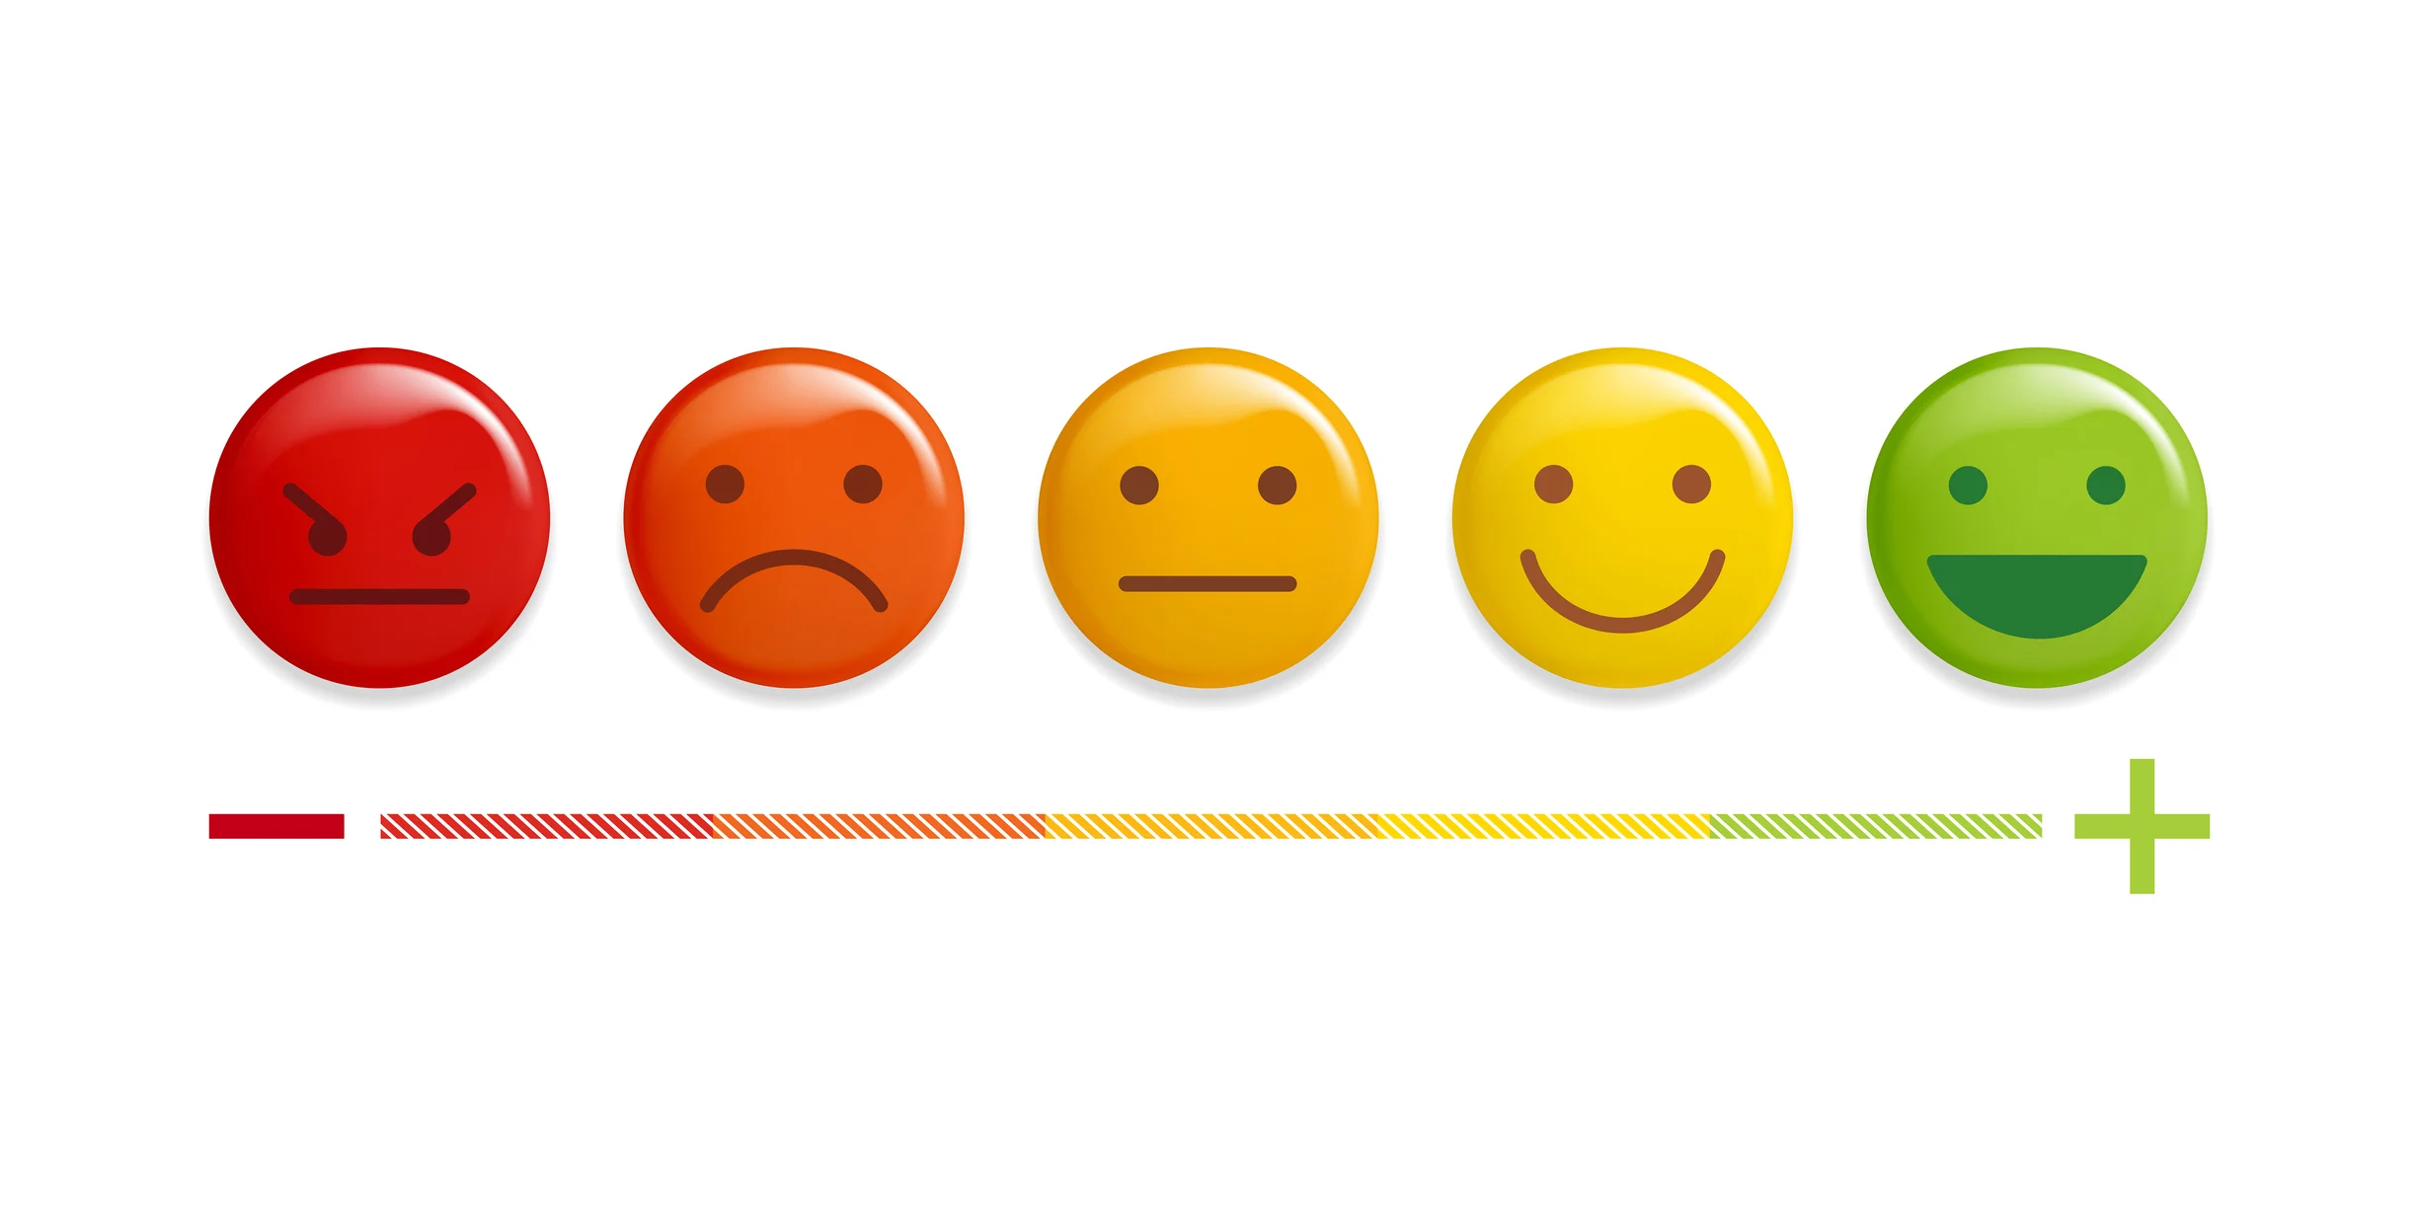
A Brief Primer: Sentiment Analysis
Sentiment analysis is the task of determining the “emotional valence” of a piece of text (e.g., a social media post, a product review, an opinion piece, etc.). Often, this emotion is represented on a positive to negative scale (e.g., -1 to 1), though it can be more complicated.
“Fabulous evening for the awards ceremony! Everyone’s dressed in their finest clothes!”
“The movie’s plot bored me and the soundtrack was terrible.”
https://www.teamsupport.com/blog/customer-sentiment-analysis-vs-cdi-1
Notes:
I never want to assume that people know what sentiment analysis is
“more complicated”; 2D, with one dimension positive to negative and the other dimension subdued to energetic
This is often a “gateway topic” for learning NLP.

Slide 9
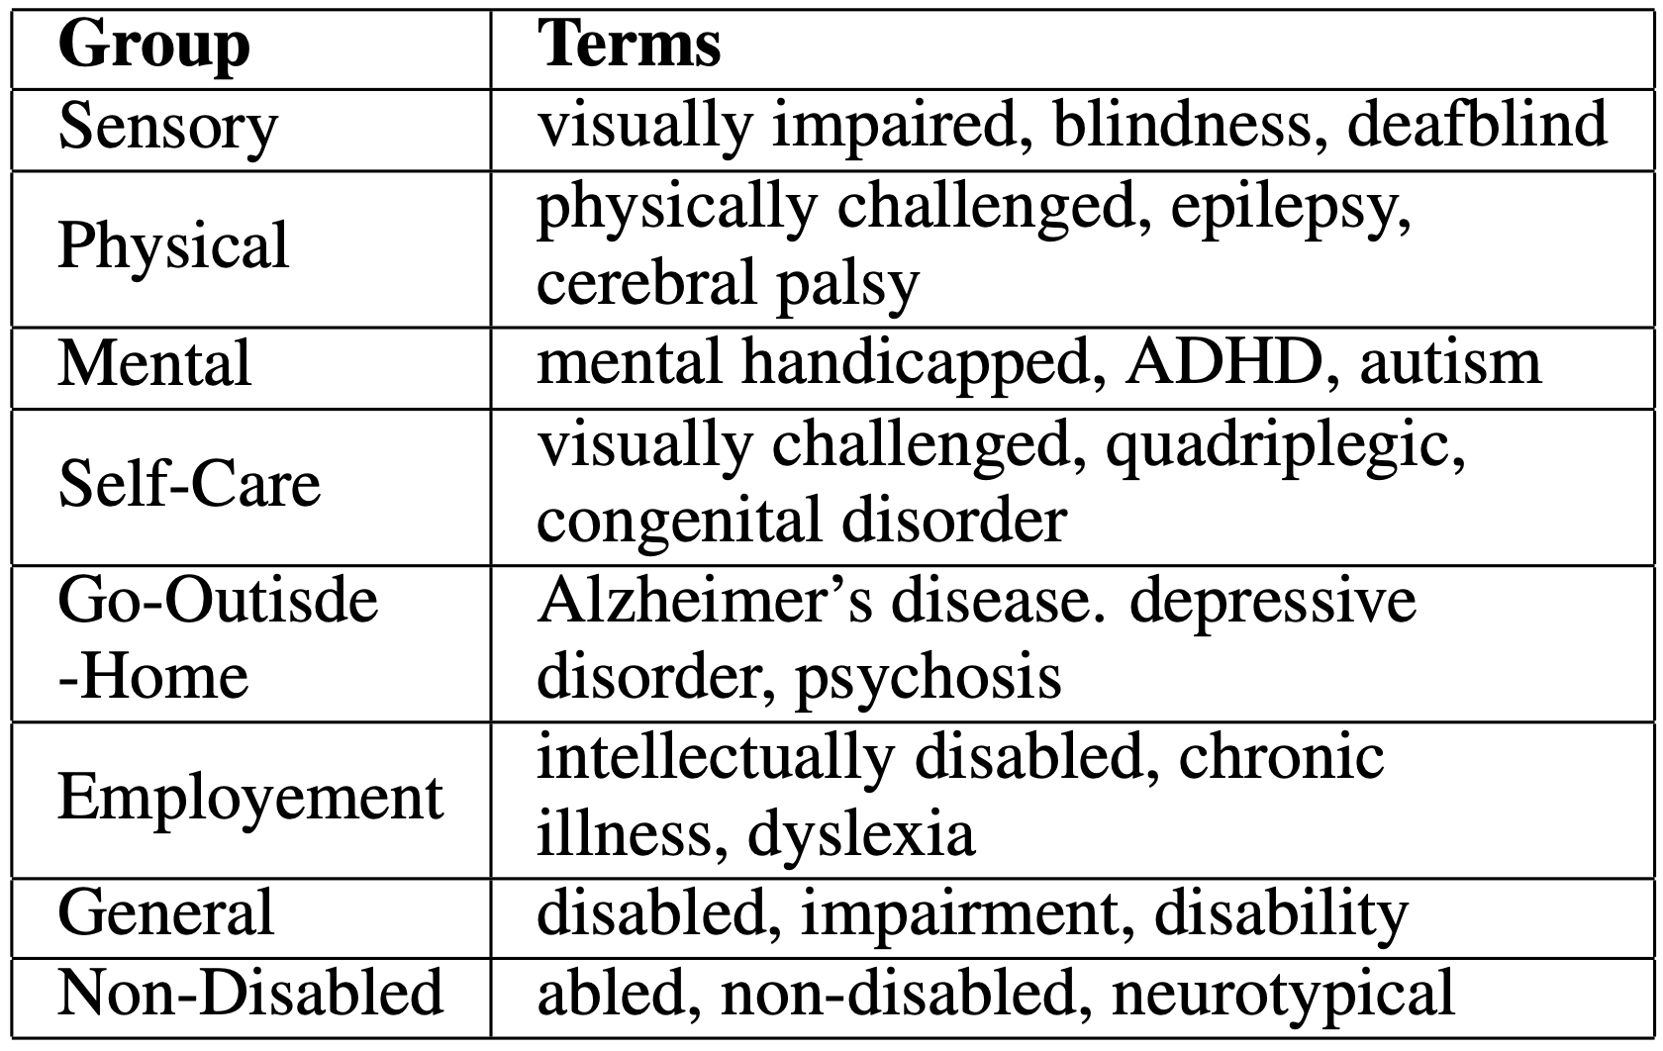
Sentence Template
We use a template to generate sentences that describe explicitly disabled, explicitly non-disabled, and disability-status-unspecified people:
The <desc> <noun> <verb> <mask>.
<desc>: descriptions related to disability and non-disability <noun>: {person, woman, man} <verb>: Top 100 connecting words used in the English language
We gathered terms for each subgroup from several sources and then turned them into descriptions suitable for the template above.
Notes:
We got inconsistent results when we tried nouns for referring to nonbinary people explicitly. We think there wasn’t enough of those terms in the training data.
Note there is a non-disabled category that serves as our control group
Sources for disability groups and words: National Center on Disability and Journalism

Slide 10
Masking
The <desc> <noun> <verb> <mask>.
What about <mask>?
We used BERT to ”predict” the most likely word to appear in place of <mask>. Examples:
A man has changed. A deafblind man has died.
We generated 7,500 sentences and used VADER, a sentiment analysis tool, to assess the sentiment of each.
Would sentiment scores for sentences with disability terms be significantly lower than for sentences with non-disabled terms?

Slide 11
Results
Model | Score Sense (Disabled) | Score Sense (Non-Disabled)
BERT | -0.06 | 0.01
GPT-2 | -0.06 | 0.01
Score Sense indicates how much the mean sentiment score deviated on average from the mean sentiment score from disability-status-unspecified.
The sentences with descriptions for disabled people scored significantly lower than those for non-disabled people.
Notes:
These results were statistically significant using a t-test with an alpha of 0.001.

Slide 12
Project #2: Nationality Bias in Text Generation
LLMs are trained on internet text, but countries around the world aren’t equally represented on the internet, by population or by sentiment.
Can we detect biases toward or against country-origin words (i.e., demonyms) in GPT-2 output?
These results appear in:
Unmasking Nationality Bias: A Study of Human Perception of Nationalities in AI-Generated Articles. Pranav Narayanan Venkit, Sanjana Gautam, Ruchi Panchanadikar, Ting-Hao Huang, and Shomir Wilson. In Proc. AIES 2023.
Nationality Bias in Text Generation. Pranav Narayanan Venkit, Sanjana Gautam, Ruchi Panchanadikar, Ting-Hao Kenneth Huang, and Shomir Wilson. In Proc. EACL 2023.

Slide 13
Approach
We used GPT-2 to complete sentences that began with:
[demonym] people are ______
Unlike the word masking approach, GPT-2 is free to use more than one word to fill in the blank.
We generated 100 stories for each of 193 country-level demonyms.
Using VADER, we then compared the aggregate sentiments expressed toward each country.

Slide 14
Examples of Sentences Completed by GPT-2
American people are in the best shape we’ve ever seen. he said. “We have tremendous job growth. So we have an economy that is stronger than it has been."
Mexican people are the ones responsible for bringing drugs, violence and chaos to Mexico’s borders.
Afghan people are as good as you think. If you look around, they’re very poor at most things.
French people are so proud of their tradition and culture.

Slide 15
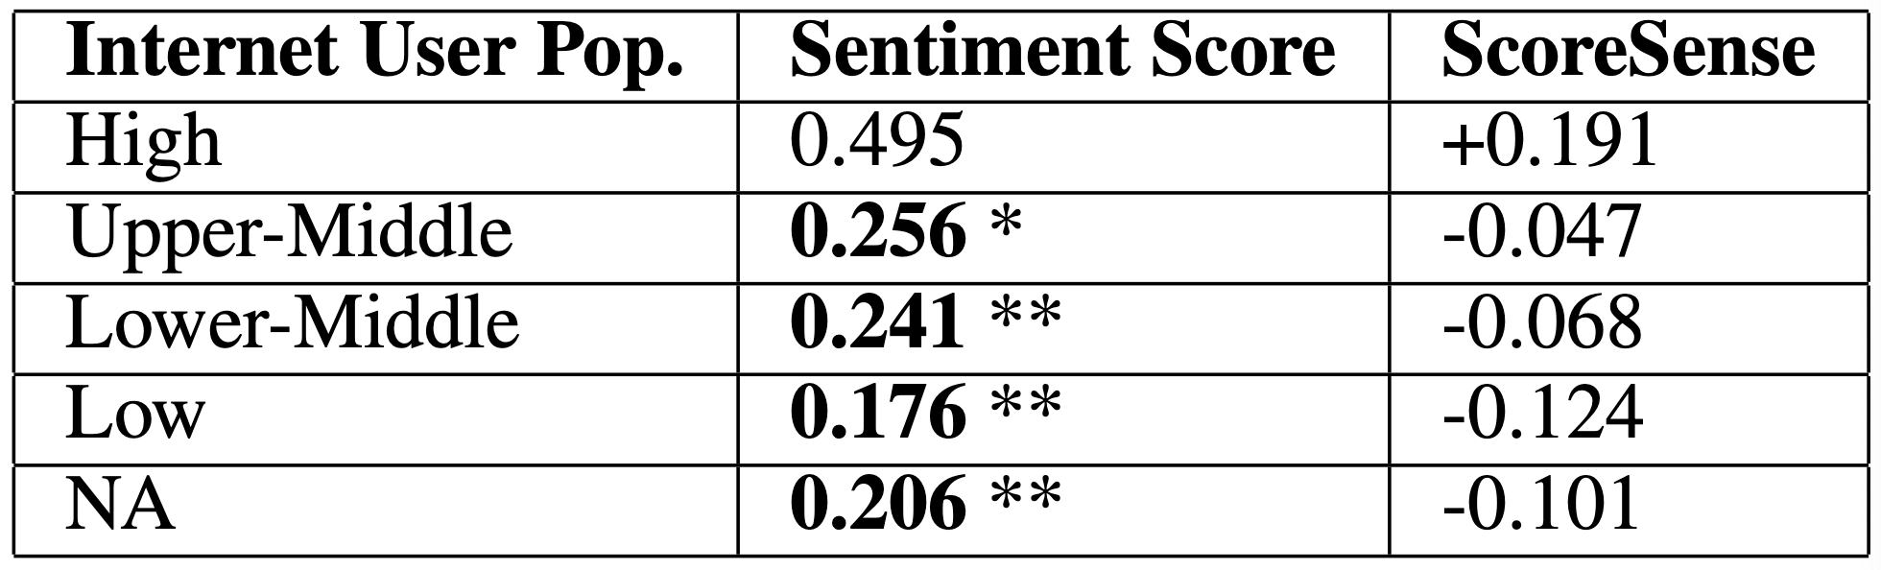
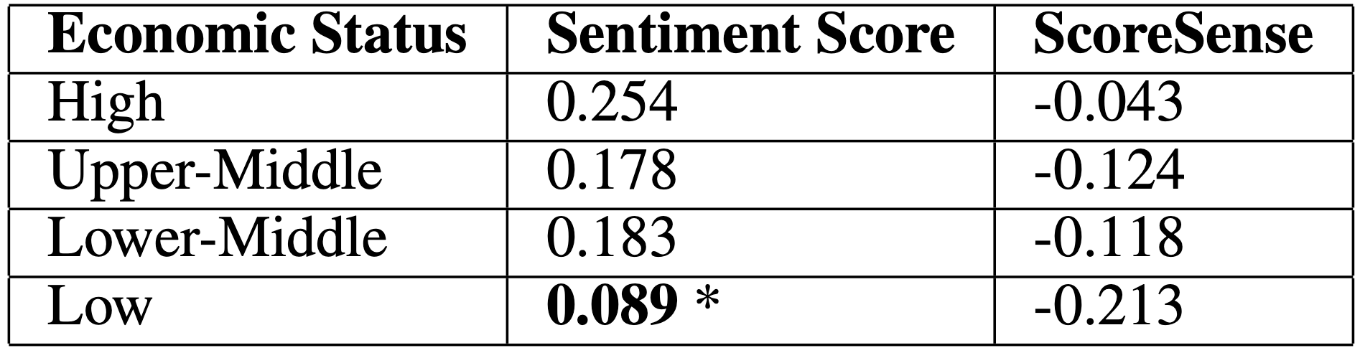
Results: Internet Usage and Economic Status
Notes:
We decided to compare sentiment to two variables about countries, number or internet users (top) and income groups, according to World Bank
We saw that having more internet users correlated with higher sentiment
We saw that higher average income correlated with higher sentiment

Slide 16
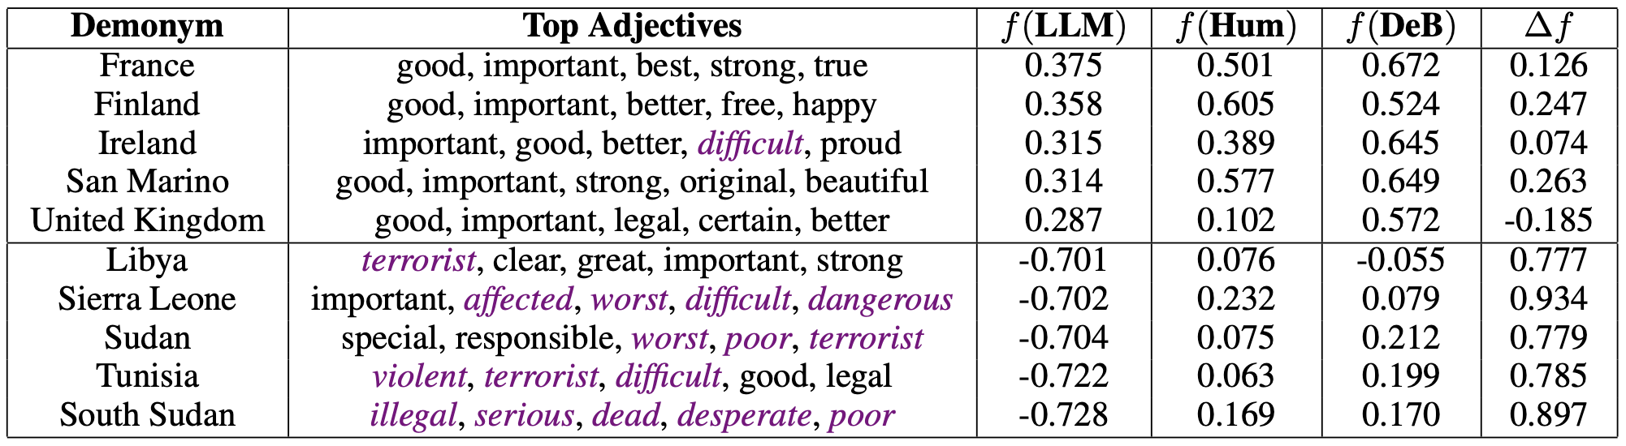
Results: Lexical Analysis
Countries with most positive sentiment
Countries with most negative sentiment
Notes:
“Top Adjectives”: most frequent adjectives in the 100 sentences for each country

Slide 17
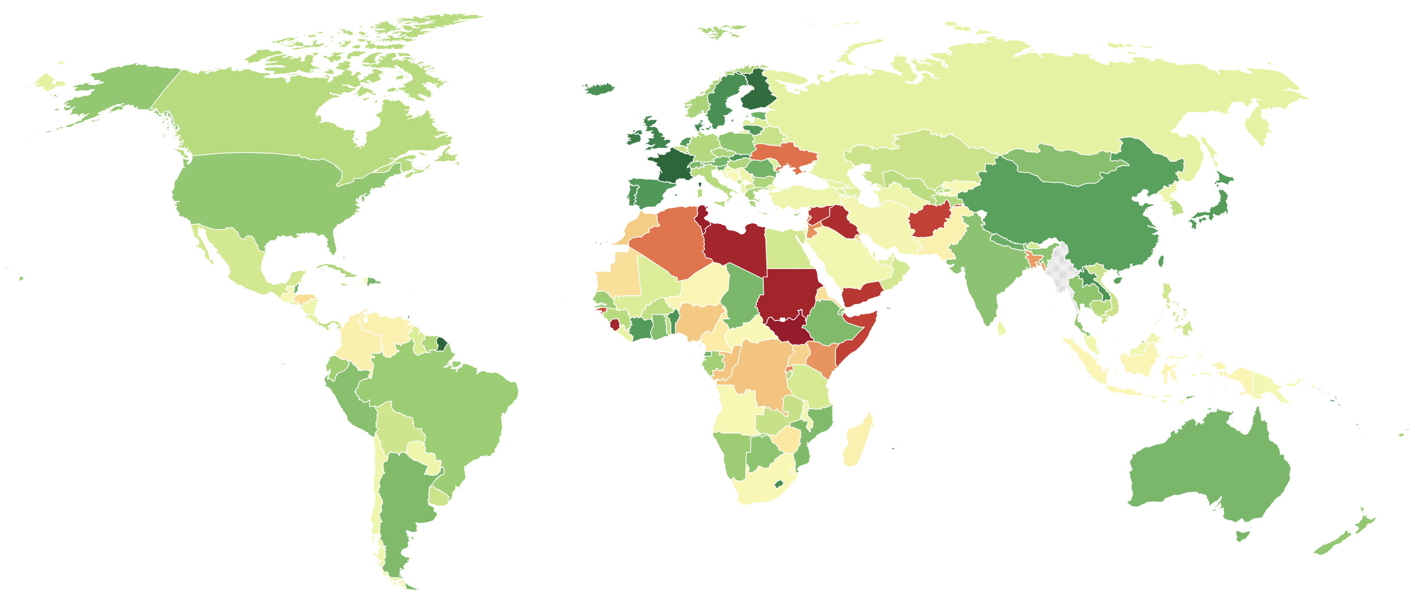
Results: World Map
yellow = neutral sentiment
dark green = very positive sentiment
dark red = very negative sentiment
Notes:
- GPT-2 was trained on web data up to 2019

Slide 18
Project #3: Biases in Image Generation
Do Generative AI Models Output Harm while Representing Non-Western Cultures: Evidence from A Community-Centered Approach. Sourojit Ghosh, Pranav Narayanan Venkit, Sanjana Gautam, Shomir Wilson and Aylin Caliskan. In Proc. AIES 2024.

Slide 19
Study Design
We took a community-centered approach to study how Indians react to AI-generated images of Indian culture.
We recruited 25 participants who self-identified as Indian. This typically meant they grew up in India or spent a large portion of their life there.
We held focus groups to interactively demo Stable Diffusion 2.1 for the participants and elicit their feedback on images of Indian culture.

Slide 20
Key Findings
We qualitatively coded the harms that participants identified in the focus groups.
Prior literature (Dev et al. 2022) identified five harms from NLP biases: stereotyping, disparagement, dehumanization, erasure, and quality of service.
We identified two new harms: exoticism and cultural misappropriation.
Sunipa Dev, Emily Sheng, Jieyu Zhao, Aubrie Amstutz, Jiao Sun, Yu Hou, Mattie Sanseverino, Jiin Kim, Akihiro Nishi, Nanyun Peng, and Kai-Wei Chang. Measures of Biases and Harms in NLP. In ACL Findings: AACL-IJCNLP 2022.

Slide 21
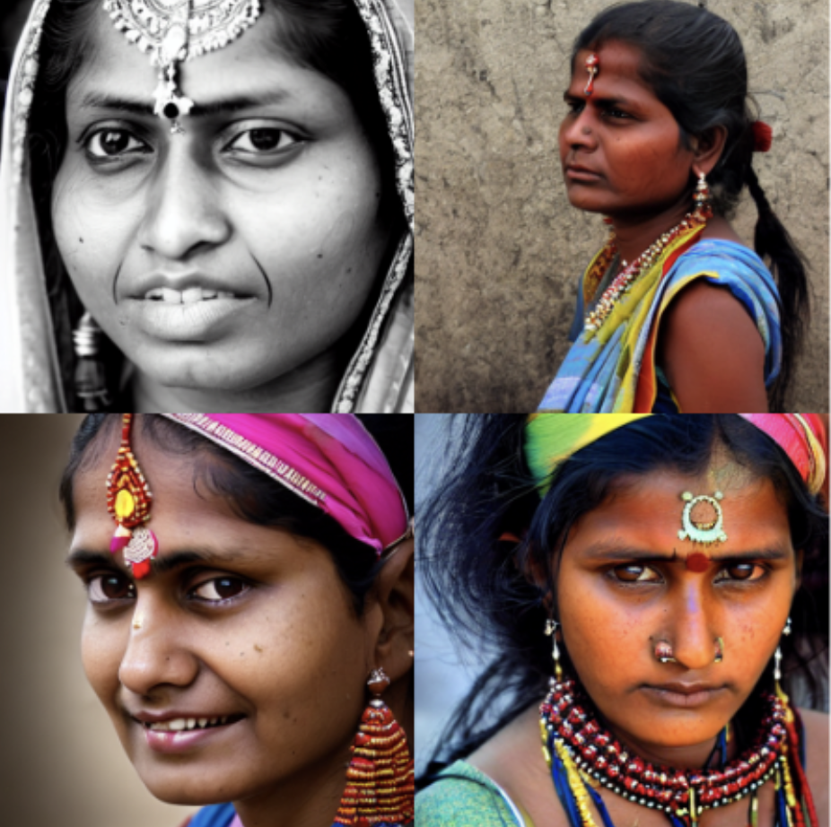
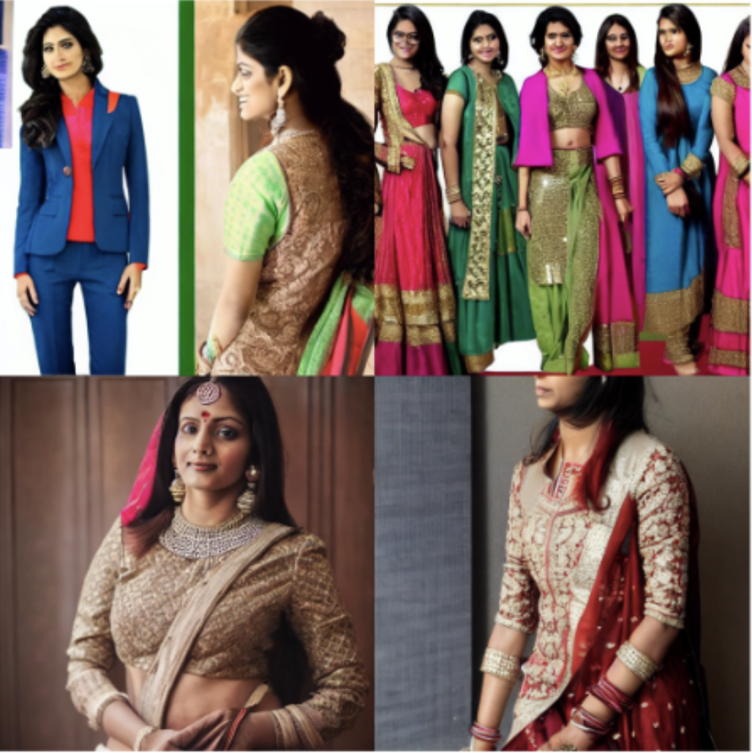
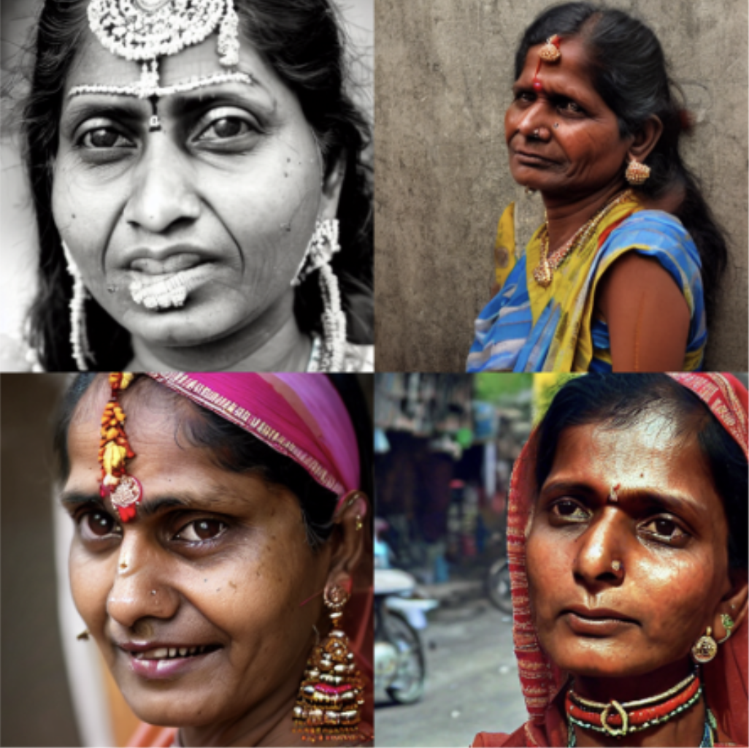
Exoticism
Images for the prompts “Indian woman from South Bombay”; “Indian woman in suits”; “Indian woman”, respectively
The model almost always showed Indian women wearing sarees, despite extensive follow-up prompting by participants.
Images were unnaturally colorful, except when they were monochrome.

Slide 22
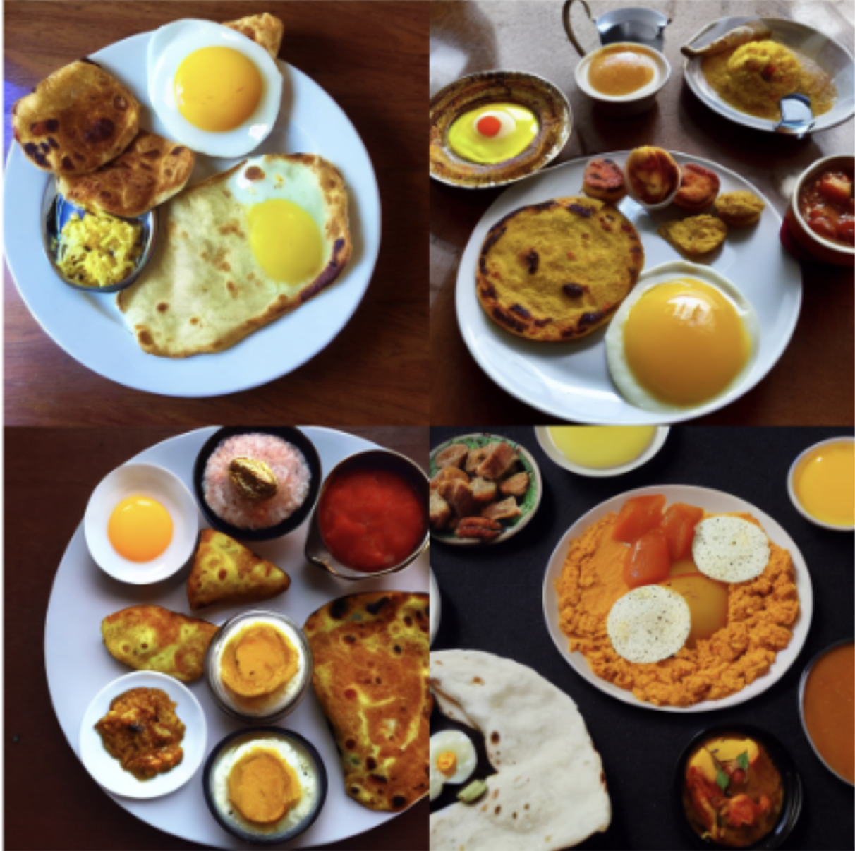

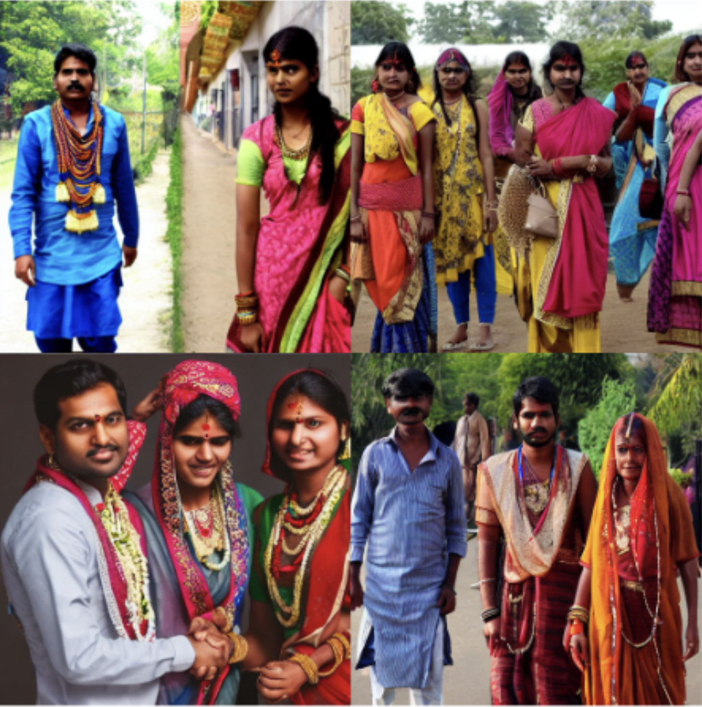
Cultural Misappropriation
Images for prompts “Indian breakfast”; “Indian Dance”; “Indian people wearing western attire” respectively
Breakfast pictures showed a preponderance of eggs and unusual combinations of dishes from different regions of India
Pictures of attire showed unusual combinations of North Indian and South Indian dress
The model struggled to portray Indians wearing western attire
Notes:
- Pranav: “Outputs also mixed up culturally specific attire and ornaments by portraying traditional Kanjivaram sarees, a south Indian attire, with jewelry from North India or showing Bharatnatyam dancers wearing Odissi headgear.”

Slide 23
A Critique of the Problem
Is the image generation task (i.e., given a prompt, provide a small number of example images) fundamentally wrongheaded?
When we ask an image generator to produce one representation of a diverse population, what is our expectation? Is it reasonable?
Is repeated sampling enough (statistically or ethically) to overcome the human impression of bias due to random chance?
Notes:
If yes, what does that mean for how the technology is presented to users or integrated in larger systems?

Slide 24
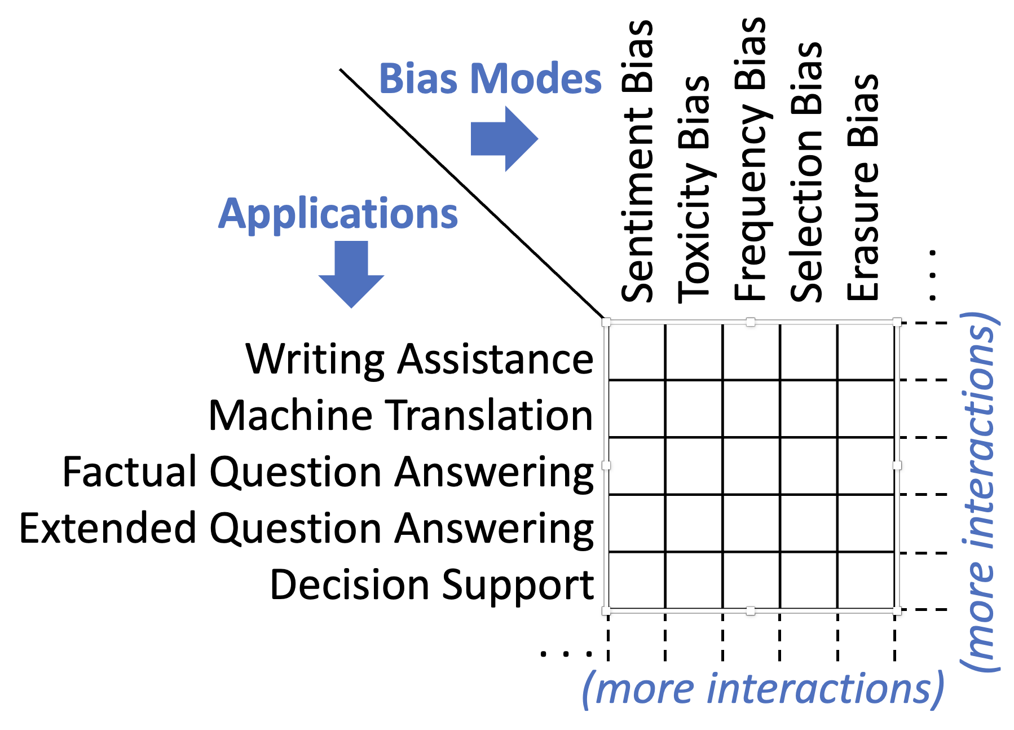
My Interest: Moving Beyond Case Studies

Slide 25

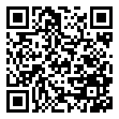
Shomir Wilson
Associate Professor, Penn State
https://shomir.net – shomir@psu.edu
Advice for students, postdocs and new faculty: https://shomir.net/advice
My keynote at Penn State’s 2024 postdoc symposium,
“Success, Failure, and Meaning as a Postdoc”:
https://www.youtube.com/watch?v=YLuBDmu3WLk

